Slide 1
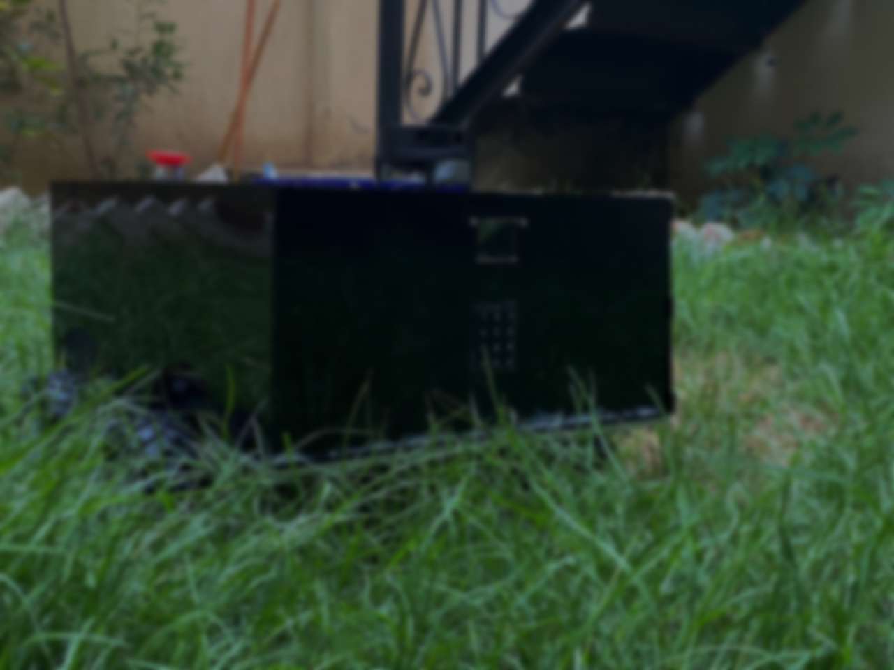


Seed Sowing Robot GROUP (5)
Seed Sowing Robot GROUP (5)
NAME | ID
Assem Yasser Mohamed Elsharbeiny | 80681
Khaled Abdelnasser Elshamndy | 80768
Omar Ashraf Abdelmawgoud | 80601
Mohamed Ahmed Mohamed Khater | 79573
Mohamed Kamal Ali Ahmed | 80651
NAME | ID
Assem Yasser Mohamed Elsharbeiny | 80681
Khaled Abdelnasser Elshamndy | 80768
Omar Ashraf Abdelmawgoud | 80601
Mohamed Ahmed Mohamed Khater | 79573
Mohamed Kamal Ali Ahmed | 80651
SEED SOWING ROBOT

Slide 2
AGENDA
01
INTRODUCTION
02
CALCULATIONS
Introduction of Robot and Objective
The calculations of motor sizing, chassis, load
03
MECHANICAL DESIGN
04
ELECTRICAL CIRCUIT
The parts of each component with sizes
Components of the circuit and the main circuit
05
NAVIGATION
06
SIMULATION
Robot Navigation Process
The simulation of the robot on RVz
07
SOFTWARE
Arduino, ESP32 and Raspberry Pi
SEED SOWING ROBOT

Slide 3
INTRODUCTION
01
SEED SOWING ROBOT

Slide 4
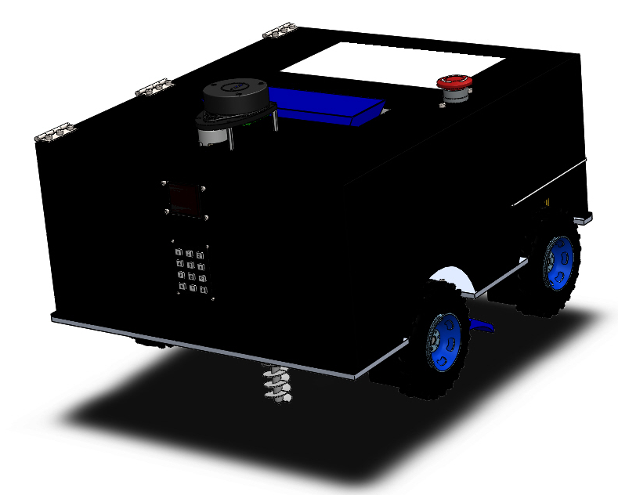
INTRODUCTION and OBJECTIVE
The seed sowing robot project revolutionizes the traditional method of manual seed sowing in agriculture by automating the process and reducing human effort. By leveraging cutting-edge technologies like ROS, mapping, localization, and path planning, the robot achieves efficient and accurate seed placement, optimizing crop yields and promoting sustainable farming practices.
SEED SOWING ROBOT

Slide 5
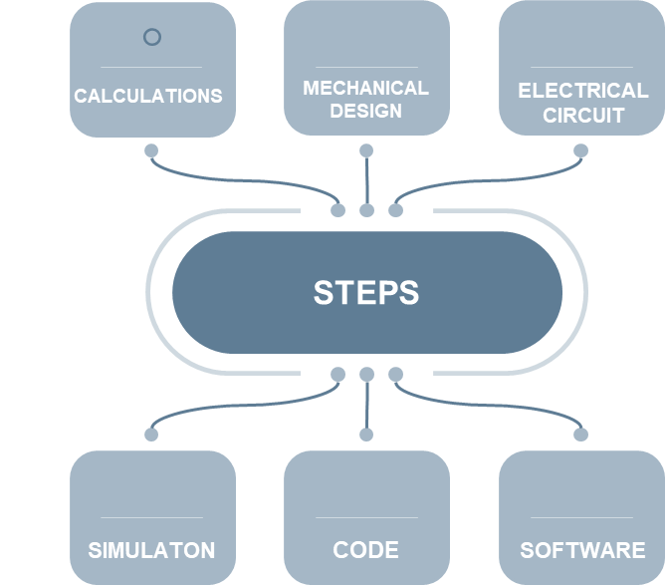



STEPS OF IMPLEMENTAION
SEED SOWING ROBOT

Slide 6
CALCULATIONS
02
SEED SOWING ROBOT

Slide 7
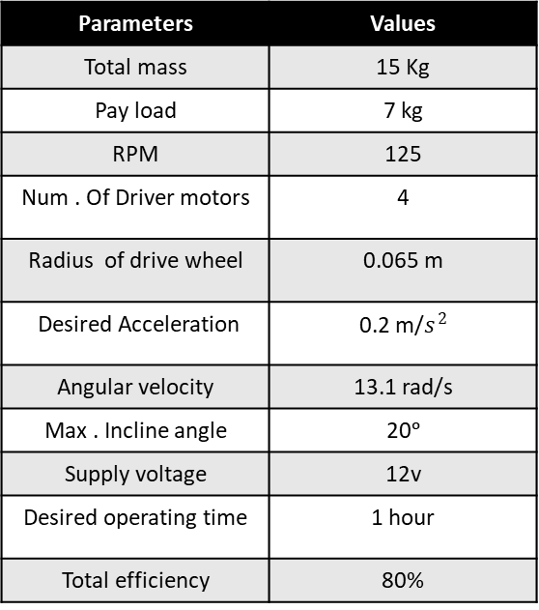
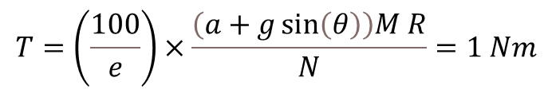
Motor sizing
Parameters | Values
Total mass | 15 Kg
Pay load | 7 kg
RPM | 125
Num . Of Driver motors | 4
Radius of drive wheel | 0.065 m
Desired Acceleration | 0.2 m/$s^{2}$
Angular velocity | 13.1 rad/s
Max . Incline angle | 20ᵒ
Supply voltage | 12v
Desired operating time | 1 hour
Total efficiency | 80%
mgx = mg * sin (ɵ)
mgy = mg * cos (ɵ)
Torque for each motor
$$T=\left(\frac{100}{e}\right)×\frac{\left(a+g\sin\left(θ\right)\right)M R}{N}=1 Nm$$
Total power (P) per motor can be calculated using the following relation:
P = T * w = 1 *13.1 = 13.1 W
Maximum current (I) requirements:
I = P/V =1.19 A
The capacity (c) of battery pack required can be estimated using the equation:
𝑐 = 𝐼 ∗ 𝑡 ∗ 𝑁 = 4.86 Ah
SEED SOWIG ROBOT

Slide 8
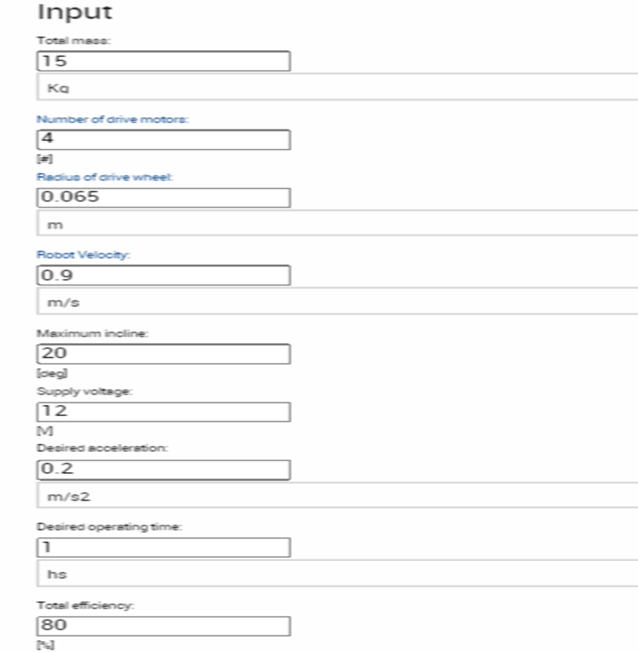
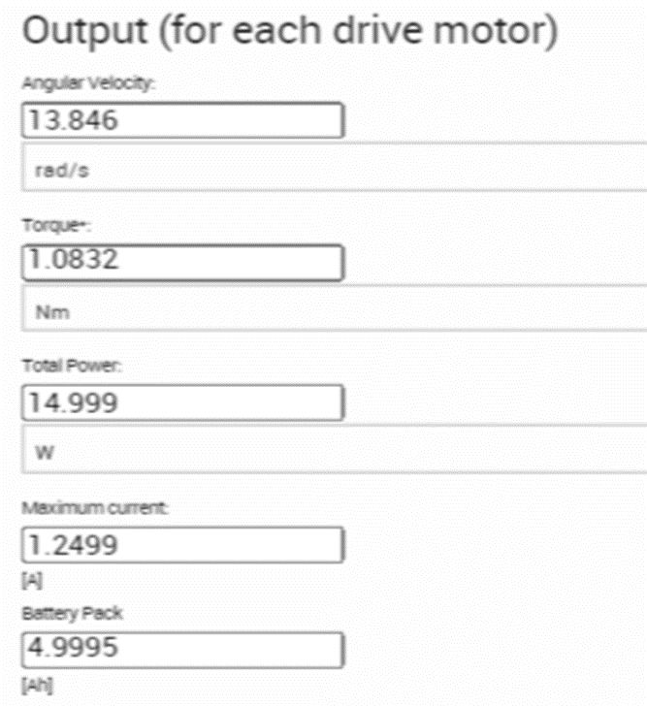
CALCULATION VALIDATION
SEED SOWIG ROBOT

Slide 9
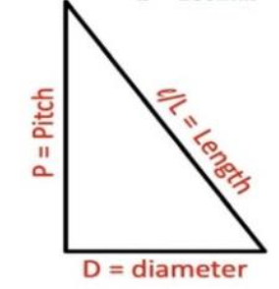
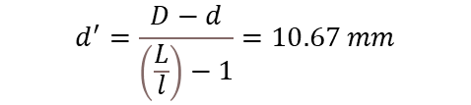
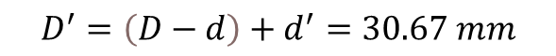
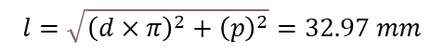
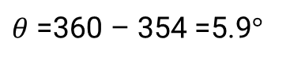
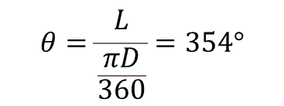
DESIGN OF AUGER
SEED SOWIG ROBOT
The auger has speed range 50-150 rpm
Pitch = 10 mm
d = 10 mm
D = 30 mm
$$θ=\frac{L}{\frac{πD}{360}}=354°$$
$$d^{′}=\frac{D−d}{\left(\frac{L}{l}\right)−1}=10.67 mm$$
$$l=\sqrt{{\left(d×π\right)}^{2}+{\left(p\right)}^{2}}=32.97 mm$$
$$D^{′}=\left(D−d\right)+d^{′}=30.67 mm$$
$θ$ =360 – 354 =5.9$°$
Screw discharge (capacity) $c_{v}=\frac{π}{4}\left(D^{2}−d^{2}\right)×p×\frac{rpm}{60}×k×3600×ρ$ = 50 𝑘𝑔/ℎ

Slide 10
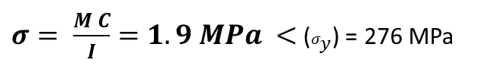
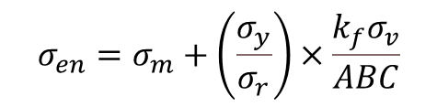
Static and fatigue stress analysis for chassis
Bending stress that applied on chassis
Length = 0.51 m
The force applied on chassis = 140 N
$$σ_{en}=σ_{m}+\left(\frac{σ_{y}}{σ_{r}}\right)×\frac{k_{f}σ_{v}}{ABC}$$
$σ= \frac{M C}{I}=1.9 MPa <$ ($σ_{y}$) = 276 MPa
$$\text{σ}\text{en}\text{=}\text{1336}\text{.}\text{6 }\text{Pa}$$
SEED SOWIG ROBOT

Slide 11
MECHANICAL DESIGN
03
SEED SOWING ROBOT

Slide 12
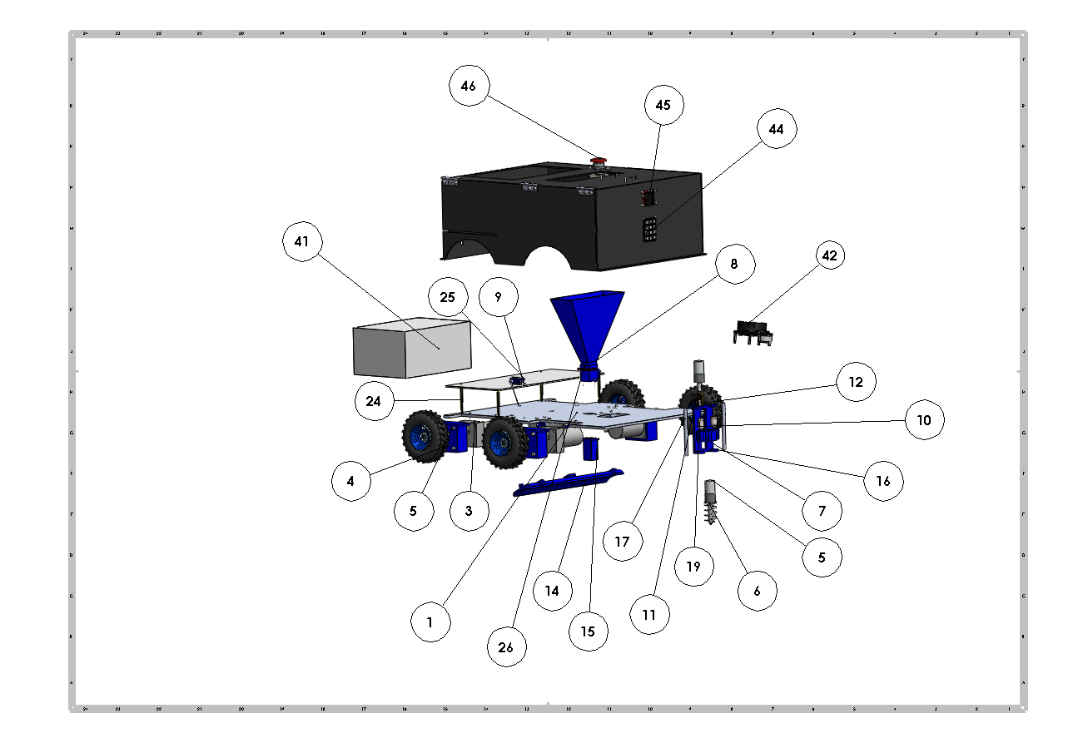
EXPLODED PARTS OF ROBOT
SEED SOWING ROBOT

Slide 13
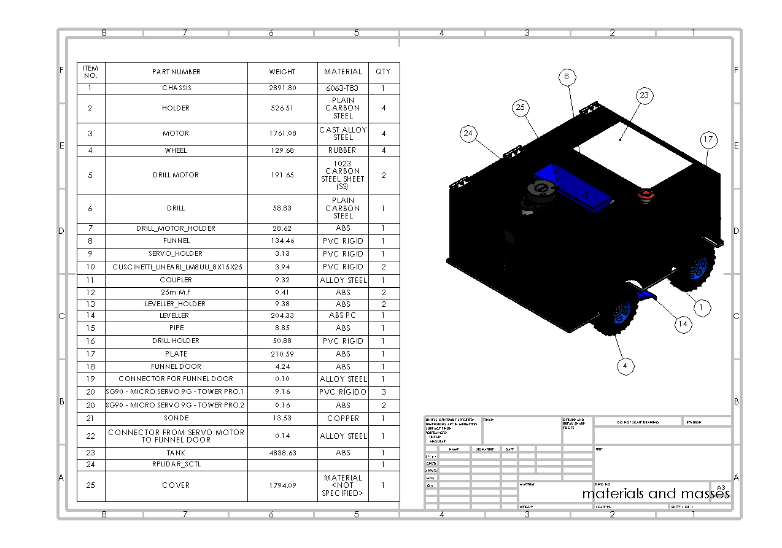
Assembly with table of parts
SEED SOWING ROBOT

Slide 14
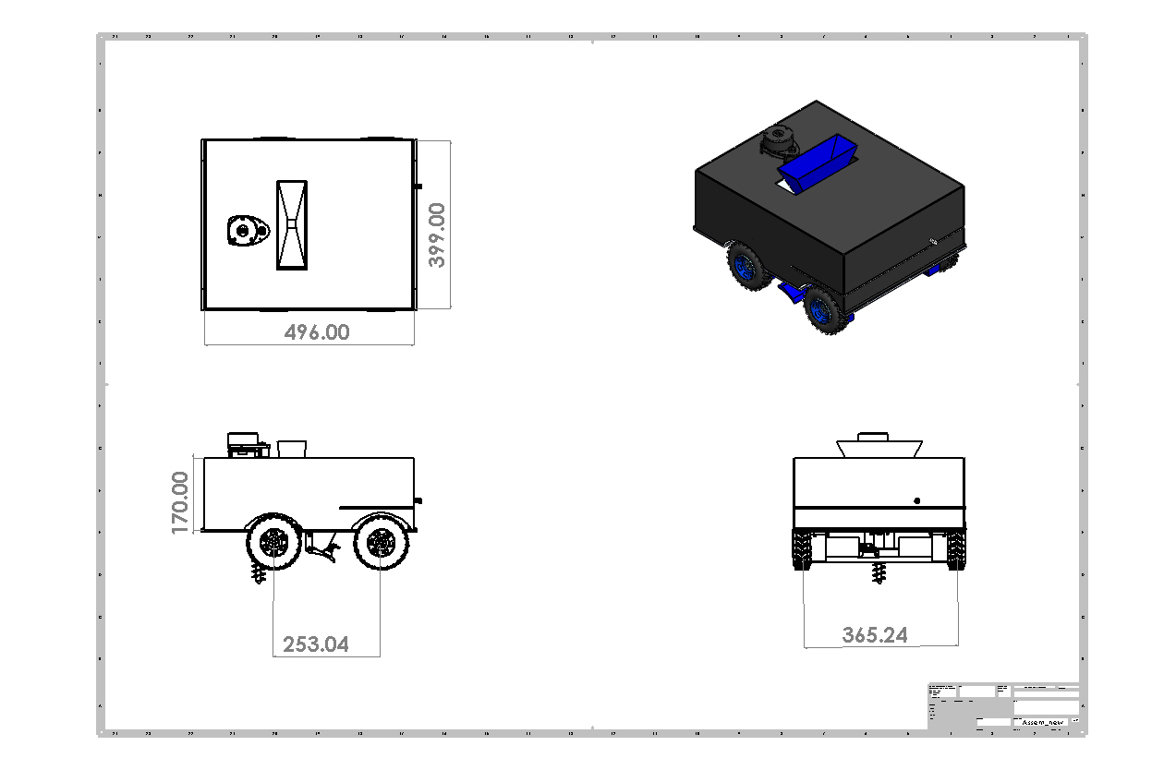
ASSEMBLY’S DIMENSIONS
SEED SOWING ROBOT

Slide 15
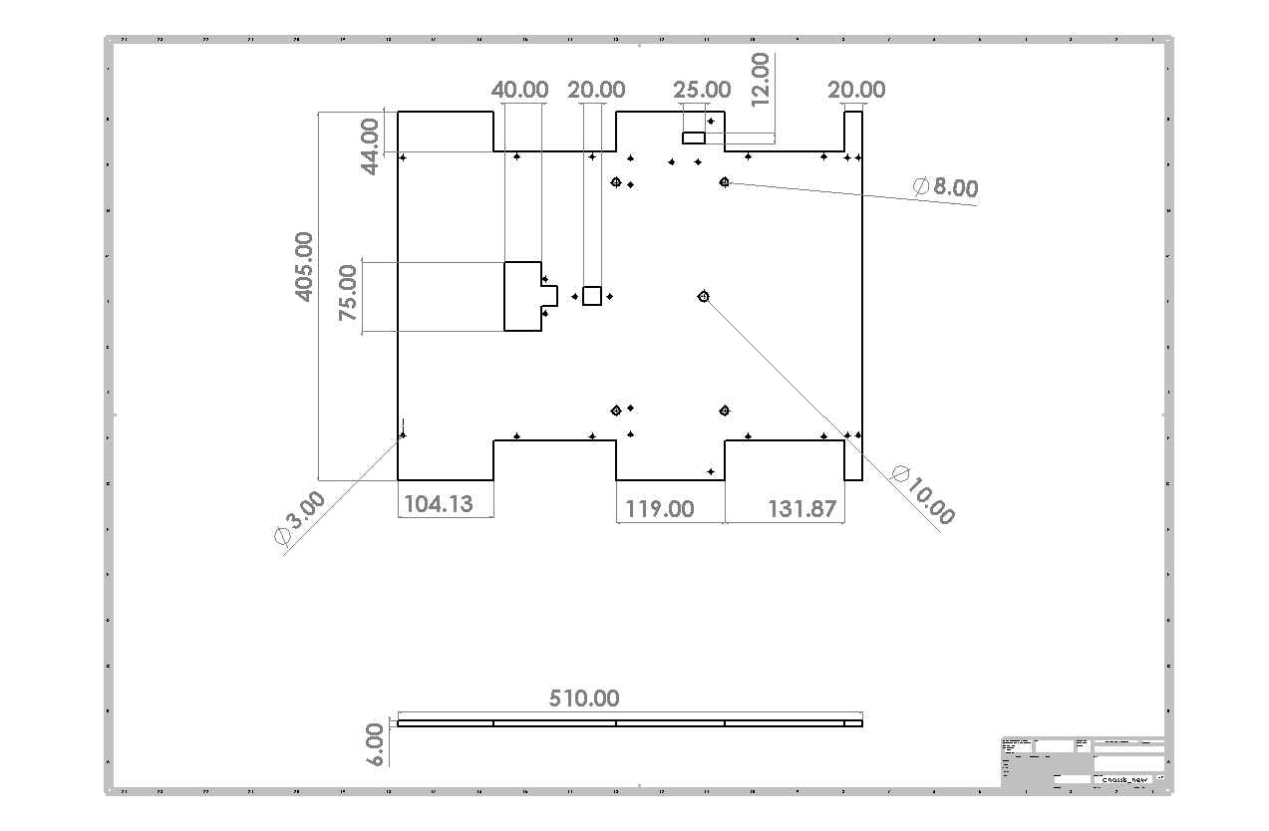
CHASSIS’S DIMENSIONS
SEED SOWING ROBOT

Slide 16
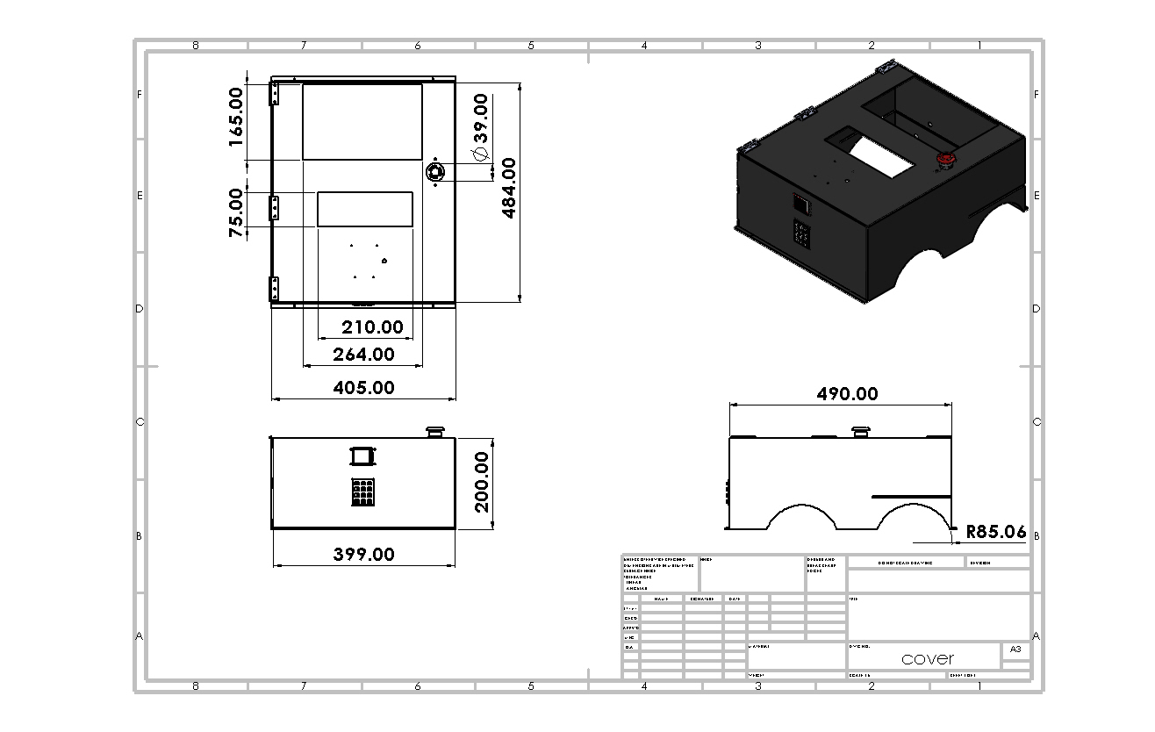
COVER’S DIMENSIONS
SEED SOWING ROBOT

Slide 17
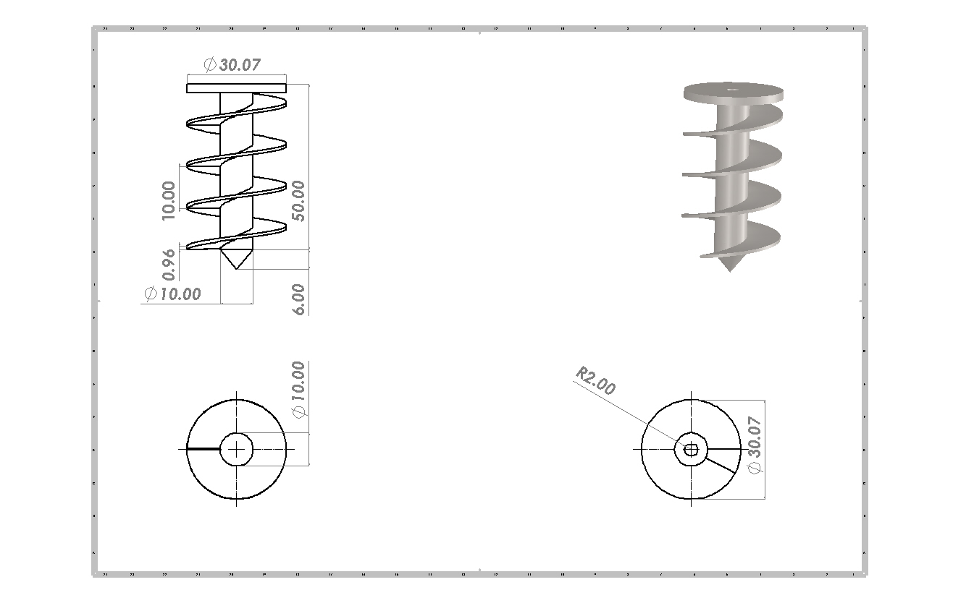
DRILL’S DIMENSIONS
SEED SOWING ROBOT

Slide 18
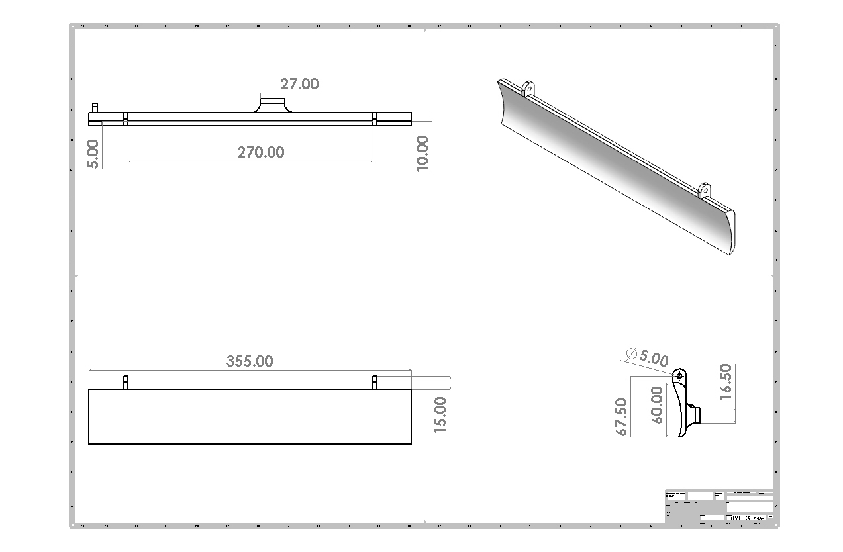
LEVELER’S DIMENSIONS
SEED SOWING ROBOT

Slide 19
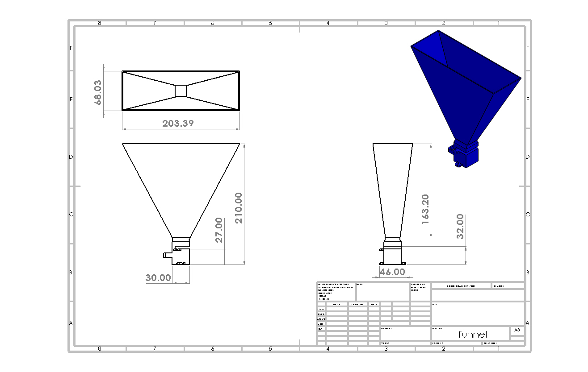
FUNNEL’S DIMENSIONS
SEED SOWING ROBOT

Slide 20
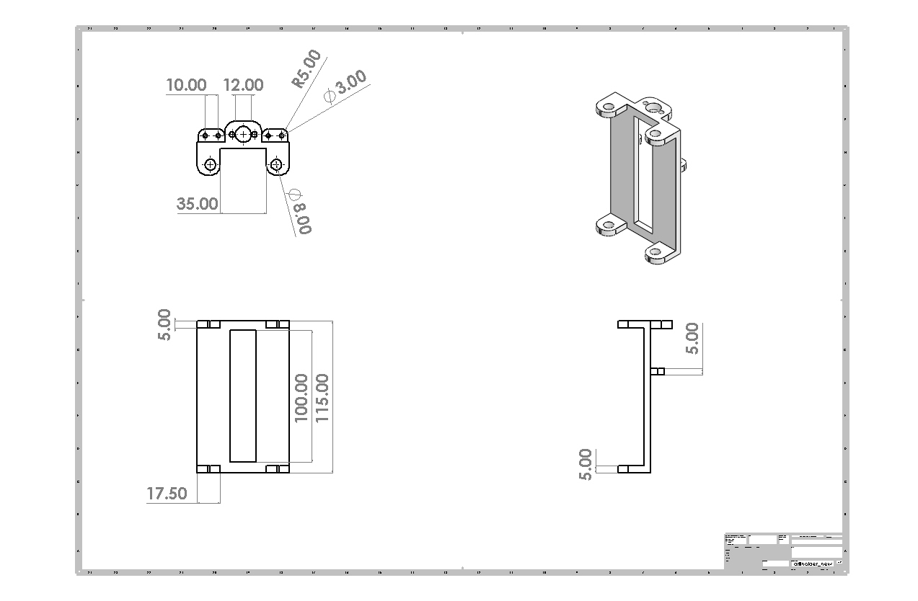
DRILL HOLDER’S DIMENSIONS
SEED SOWING ROBOT

Slide 21
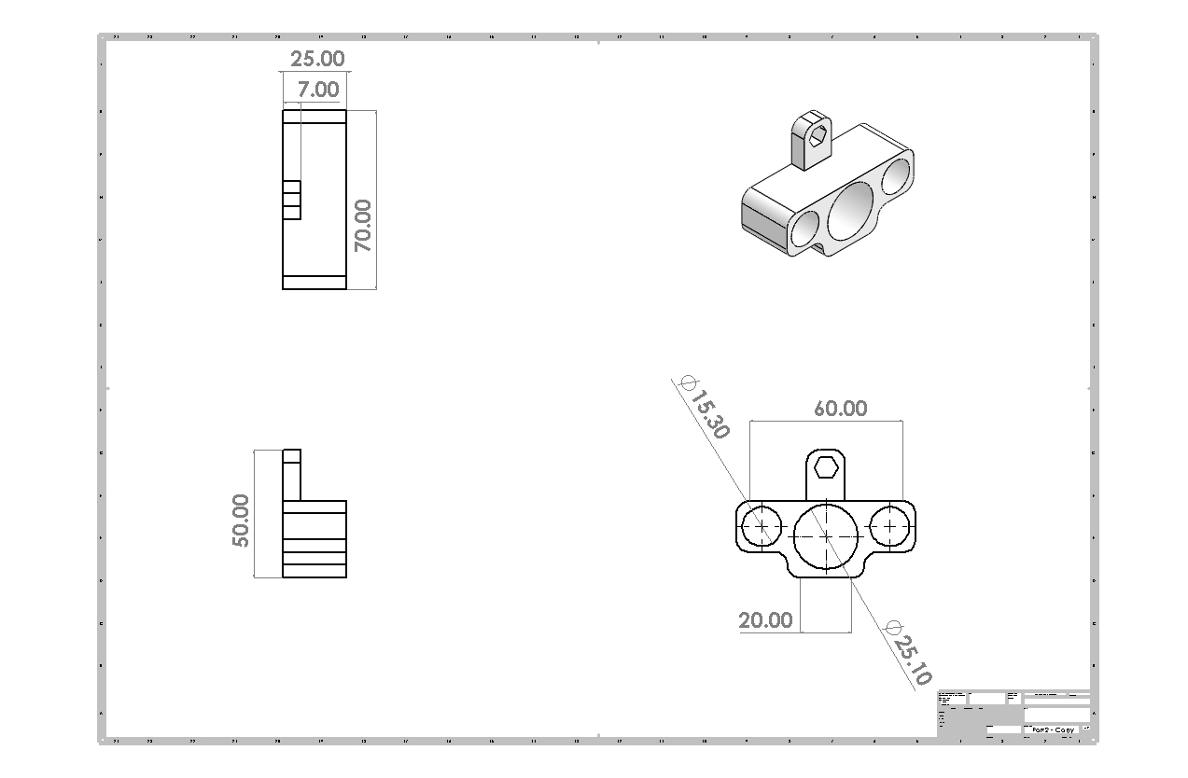
DRILL HOLDER’S DIMENSIONS
SEED SOWING ROBOT

Slide 22
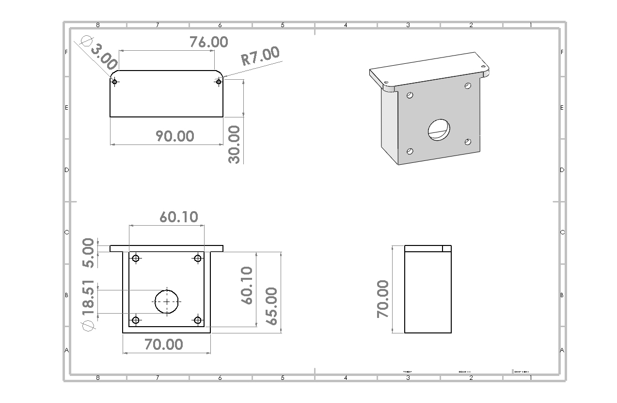
MOTOR HOLDER’S DIMENSIONS
SEED SOWING ROBOT

Slide 23
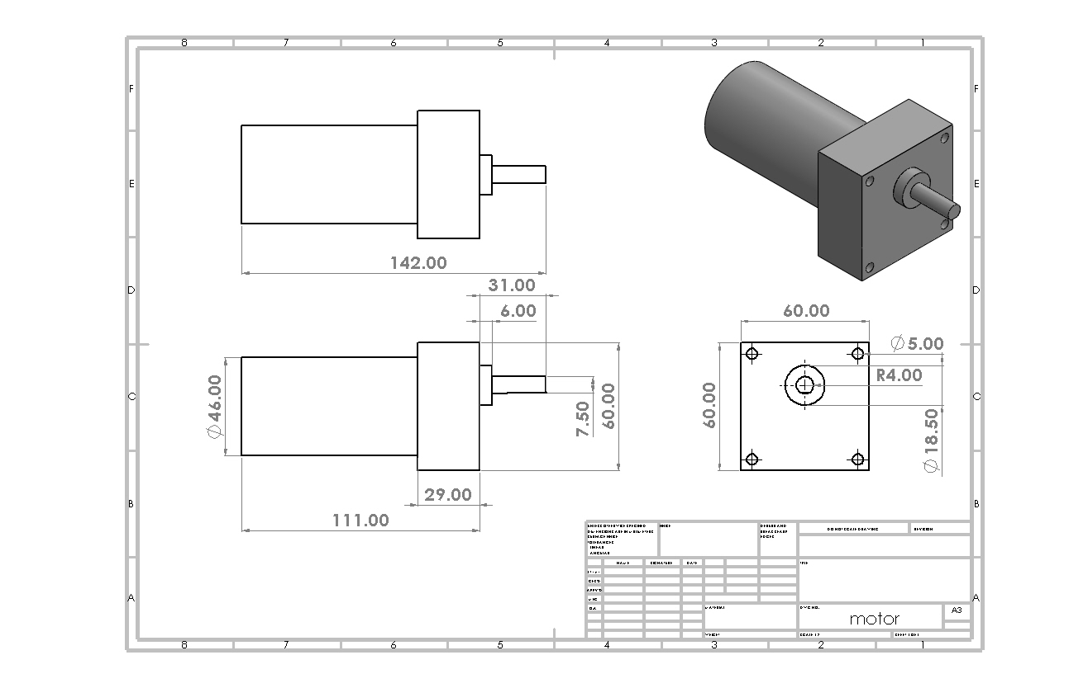
WHEEL MOTOR’S DIMENSIONS
SEED SOWING ROBOT

Slide 24
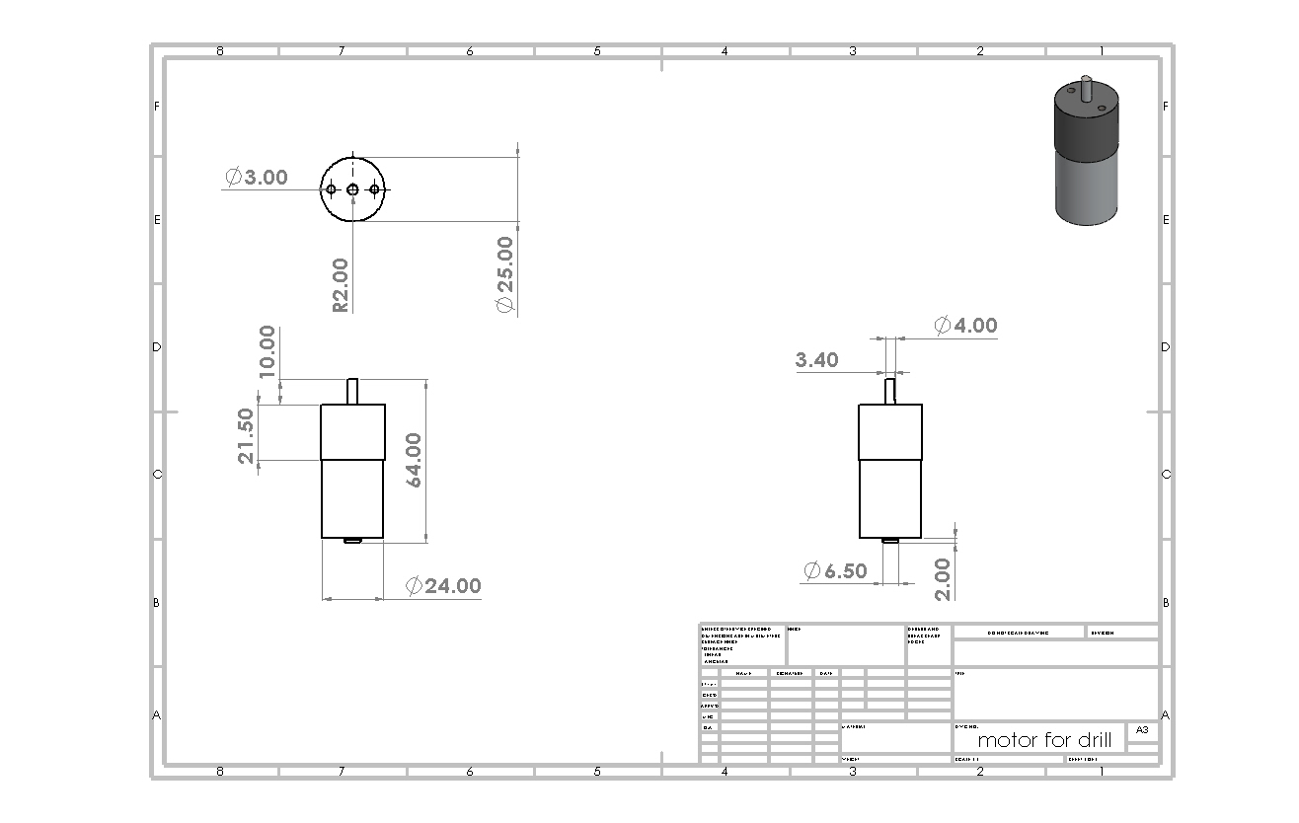
DC MOTOR’S DIMENSIONS
SEED SOWING ROBOT

Slide 25
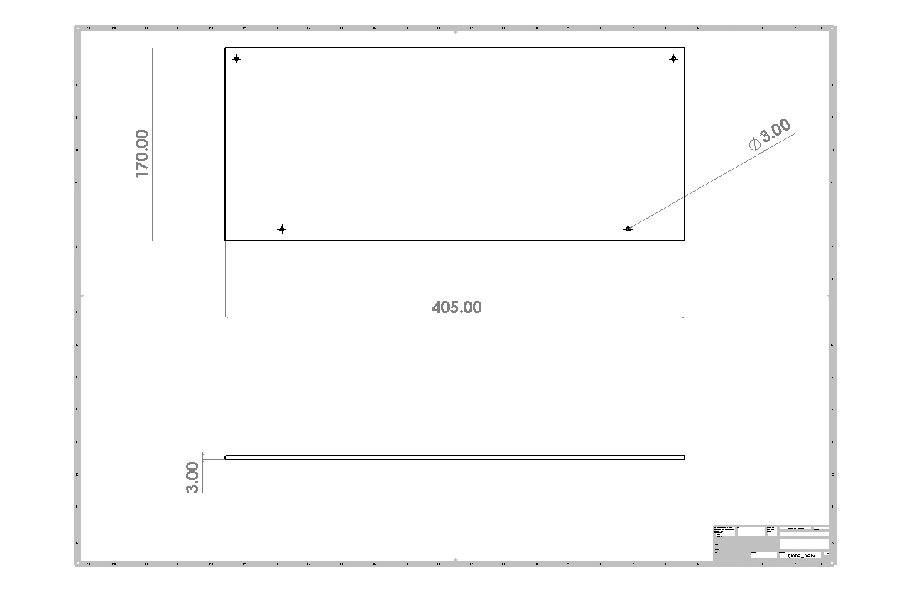
PLATE’S DIMENSIONS
SEED SOWING ROBOT

Slide 26
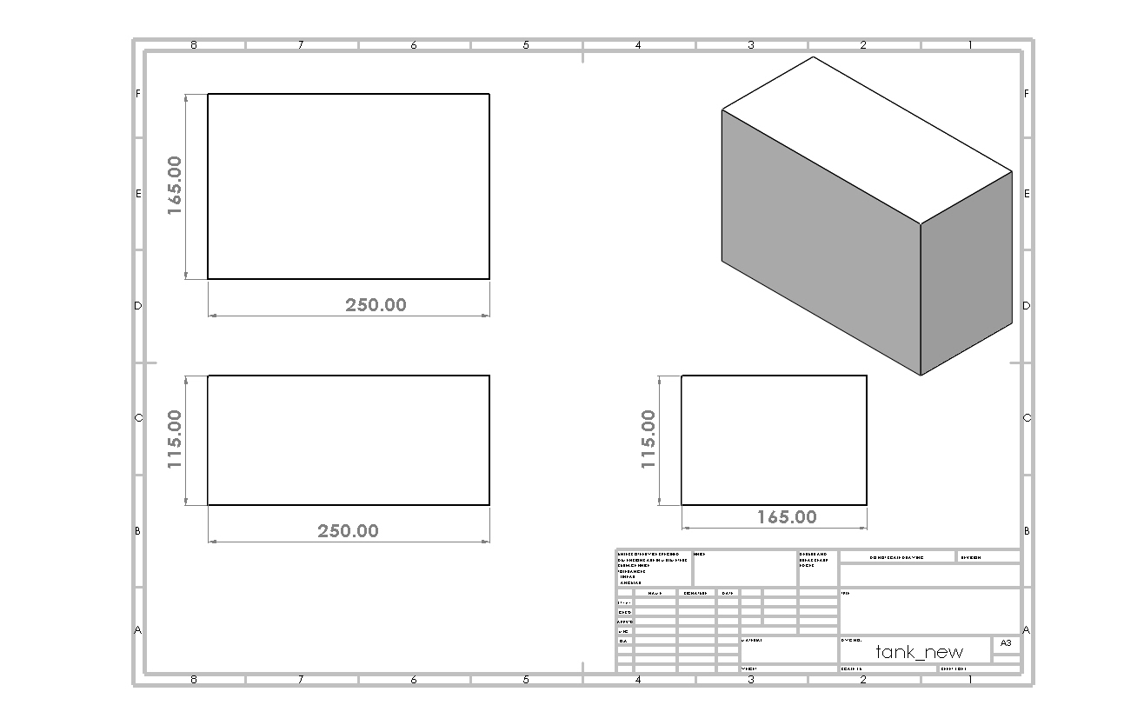
TANK’S DIMENSIONS
SEED SOWING ROBOT

Slide 27
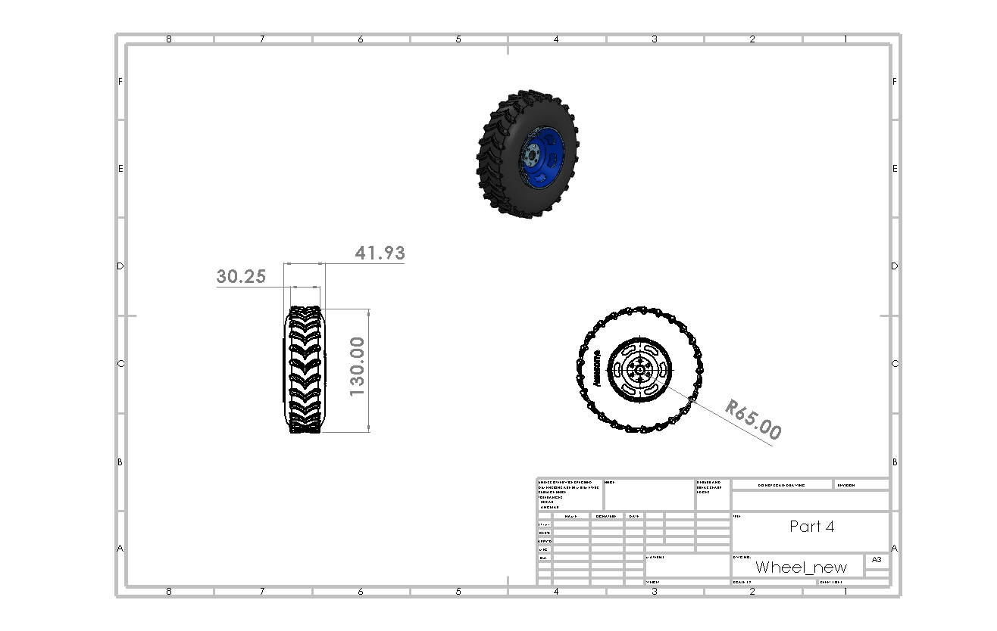
WHEEL’S DIMENSIONS
SEED SOWING ROBOT

Slide 28
ELECTRICAL CIRCUIT
04
SEED SOWING ROBOT

Slide 29
ELECTRICAL CIRCUIT
Component | Quantity
Raspberry Pi 4 Model B | 1
ESP32 microcontroller | 1
Arduino Mega | 1
RPLidar A1M8 LiDAR sensor | 1
DC Motor with Gearbox 12V | 4
Servo motor SG90 | 3
Cytron MDD 10A motor drivers | 2
MPU9250 sensor (accelerometer and gyroscope) | 1
12V lithium-ion DC battery | 1
Emergency button | 1
DC to DC buck converter | 1
TFT LCD display | 1
External Rotary Encoder | 4
4*3 Keypad | 1
Water pump 12V | 1
Moisture Sensor | 1
Level Sensor | 1
relay module | 1
L298N Driver Motor | 1
Wire connectors | -
Current sensor | 1
DC motor With encoder | 2
DC motor with gearbox | 1
SEED SOWING ROBOT

Slide 30
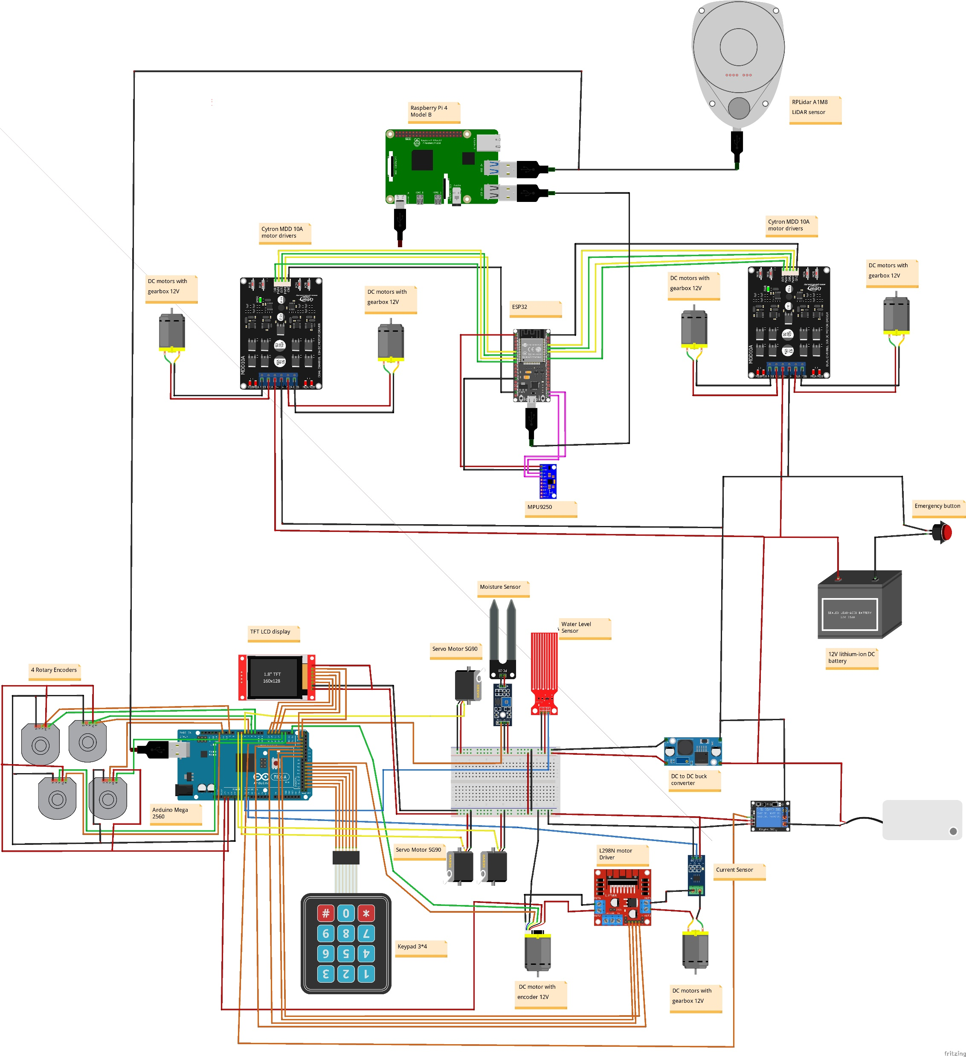
ELECTRICAL CIRCUIT
SEED SOWIG ROBOT

Slide 31
NAVIGATION
SEED SOWING ROBOT
05

Slide 32
What is gmapping:
gmapping ROS package is an implementation of a specific SLAM algorithm called gmappin.
Hardware Requirements configuration:
Provide Good Laser Data
Provide Good Odometry Data

Slide 33
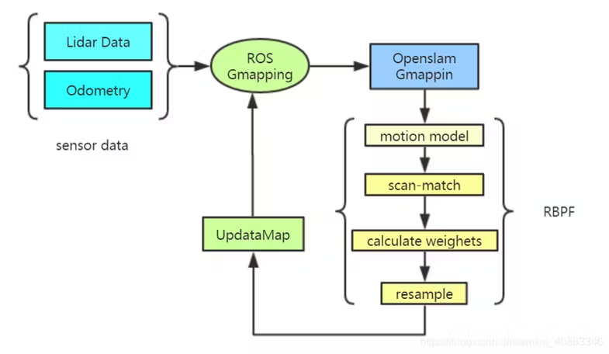
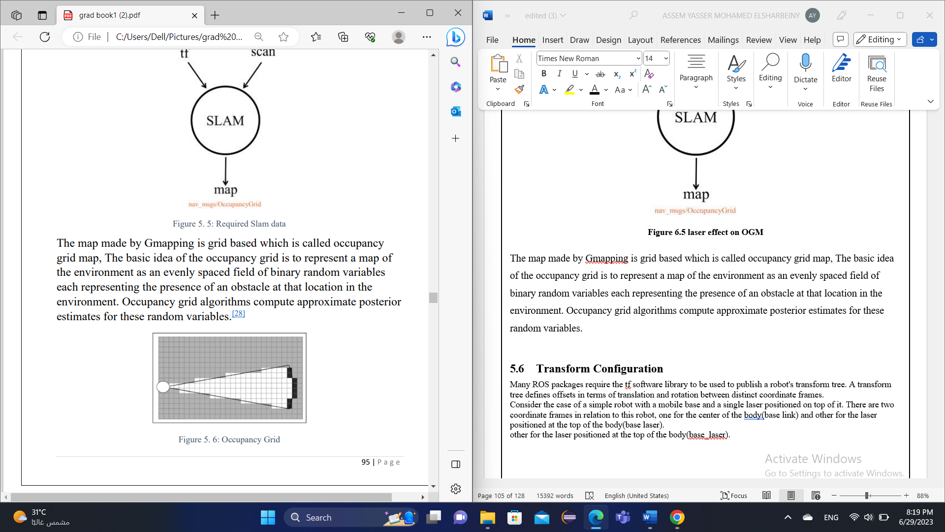
Gmapping
SEED SOWING ROBOT

Slide 34
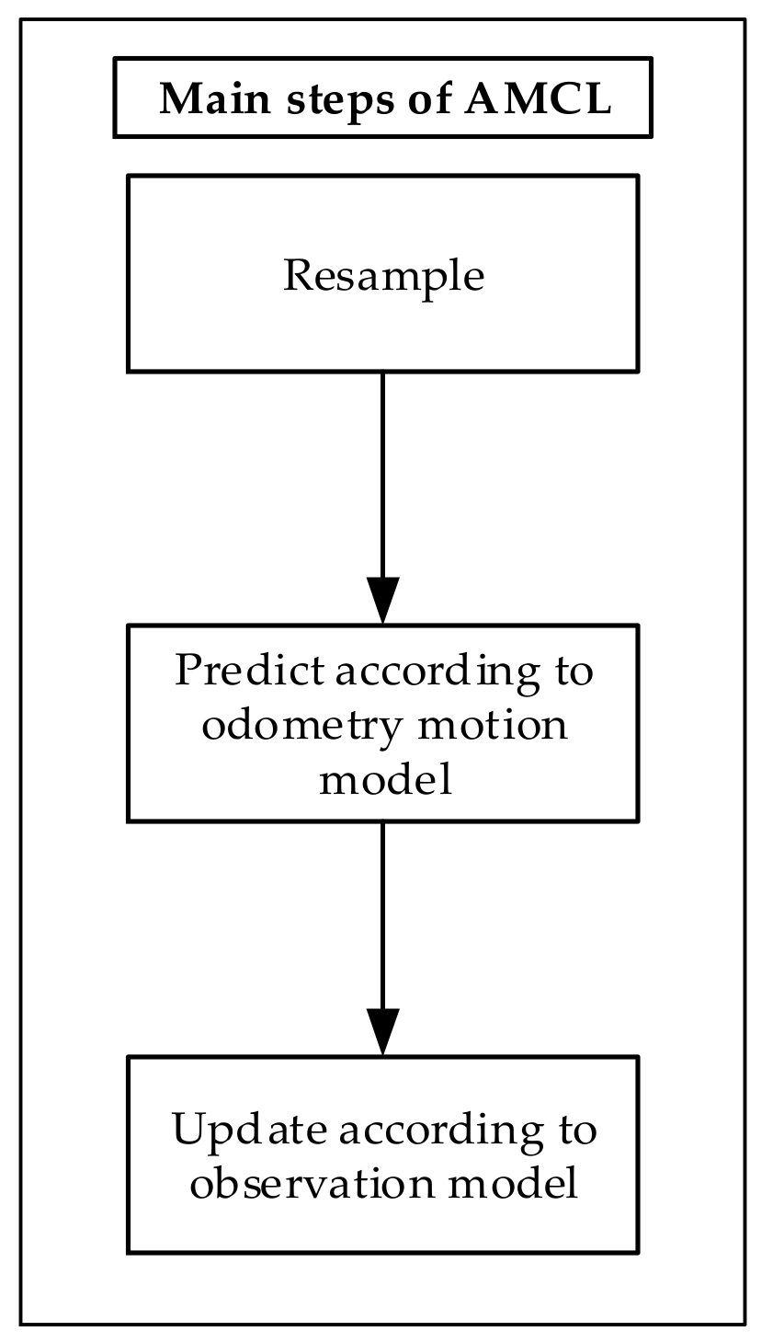
AMCL
Hardware Requirements:
Provide Good Laser Data
Provide Good Odometry Data
Provide Good Laser-Based Map Data
OUTPUT:
AMCL outputs an estimated pose of the robot. The more the robot moves around the environment, the more data the localization system will get, so the more precise the estimated pose it returns will be
SEED SOWING ROBOT

Slide 35
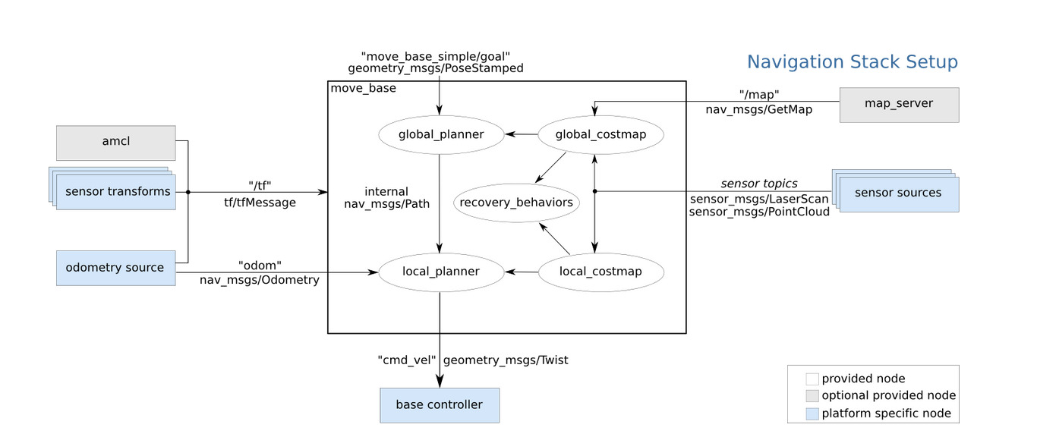
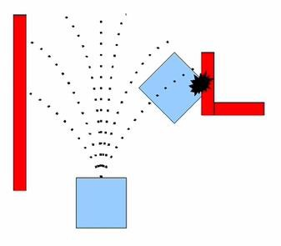
Navigation stack
SEED SOWING ROBOT

Slide 36
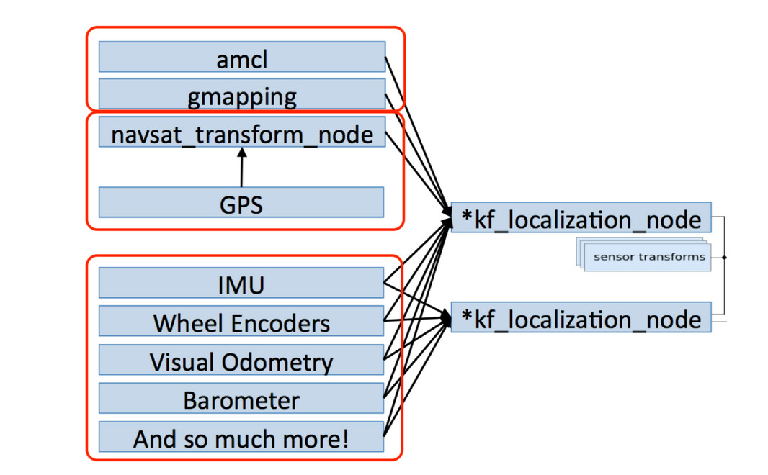
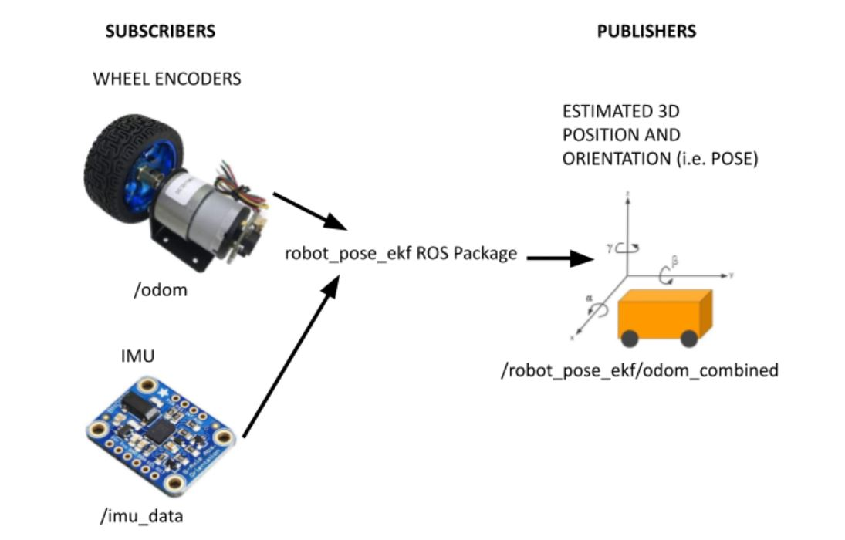
Sensor fusion
SEED SOWING ROBOT

Slide 37
SIMULATION
06
SEED SOWING ROBOT

Slide 38

SIMULATION
Key Benefits of Robot Simulation:
1-Visualization and debugging:
Running a simulation provides all the information you need about the environment and the robot.
2-Fail fast, learn faster:
Failing on a simulated robot is faster and cheaper.
3-Building a robot is too expensive :
test algorithms on a real robot is too expensive.
SEED SOWING ROBOT

Slide 39
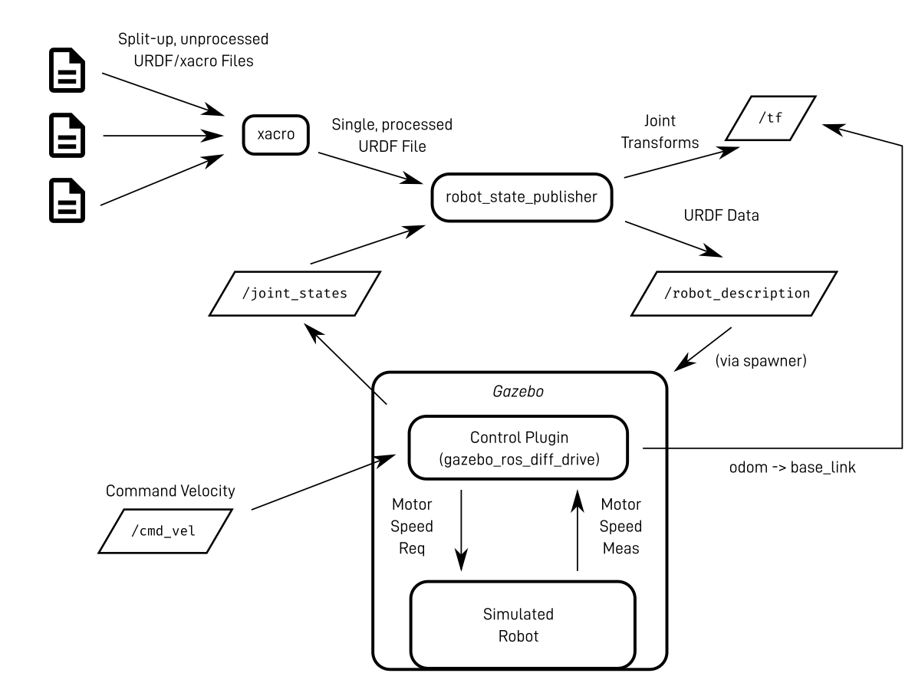
Steps of simulation
1- Build a Robot:
URDF(XACRO).
Adding gazebo plugins.
2- Connect to ROS:
Gazebo's ROS node.
The gazebo service node
/gazebo/spawn_urdf_model.
3-launch gmapping.launch
4-launch amcl.launch
5-launch navigation.launch
SEED SOWING ROBOT

Slide 40
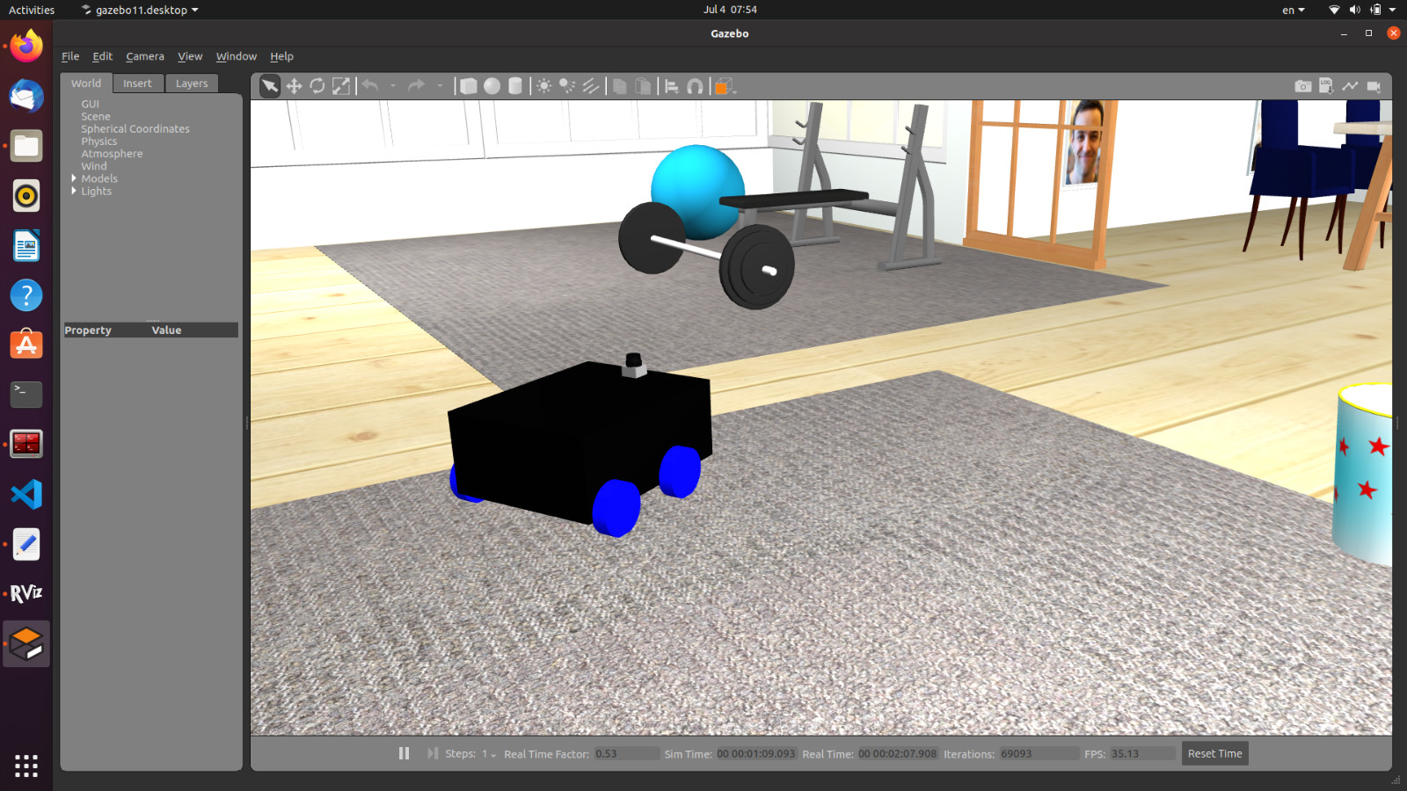
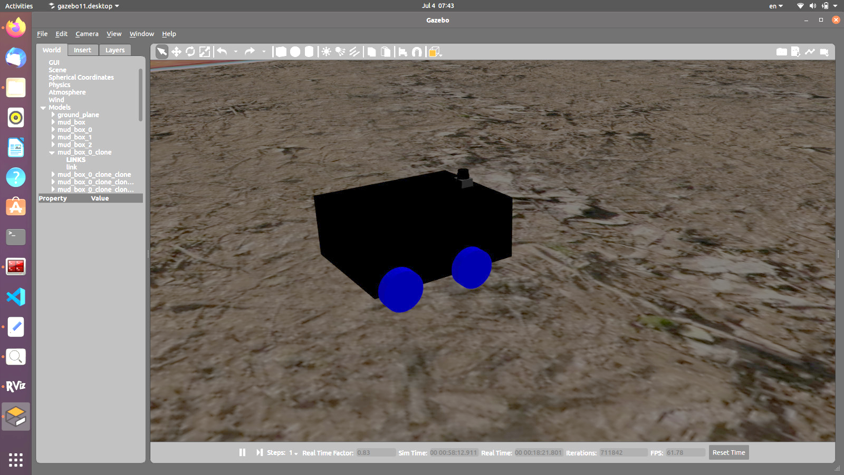
URDF
SEED SOWING ROBOT

Slide 41
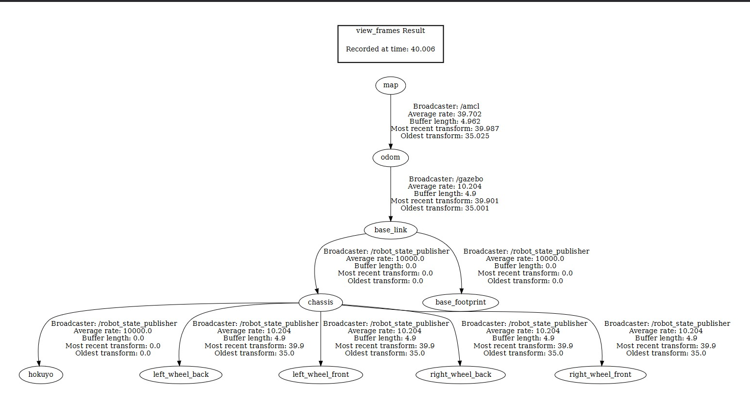
TF
SEED SOWING ROBOT

Slide 42
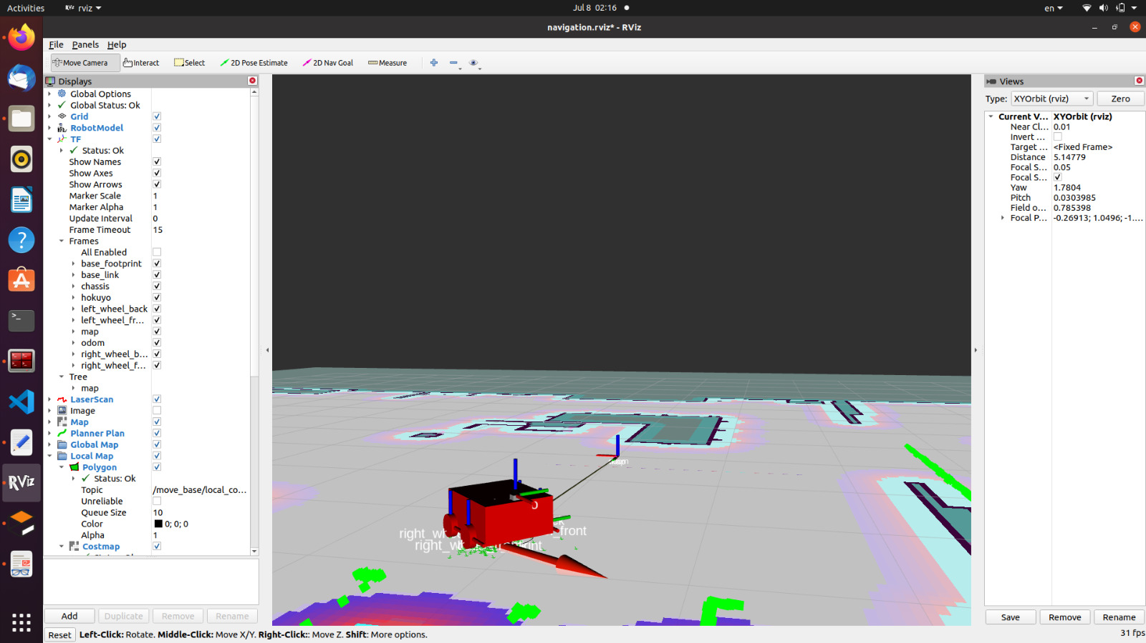
TF
SEED SOWING ROBOT

Slide 43
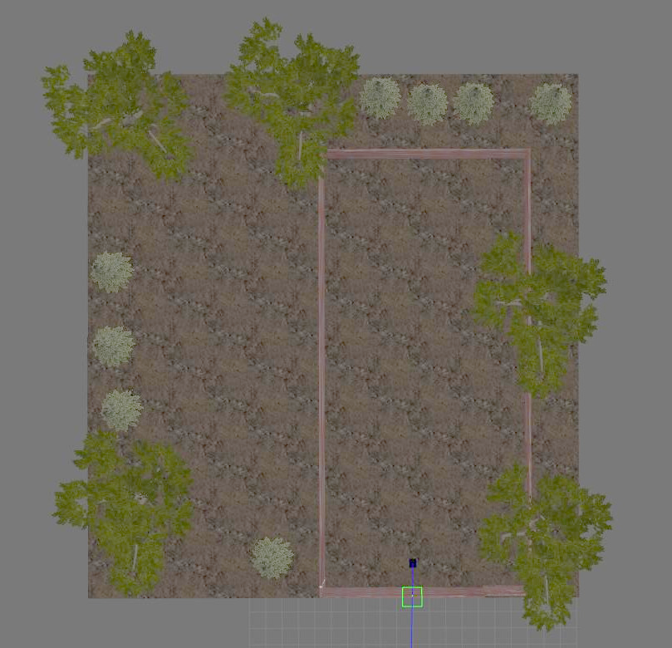
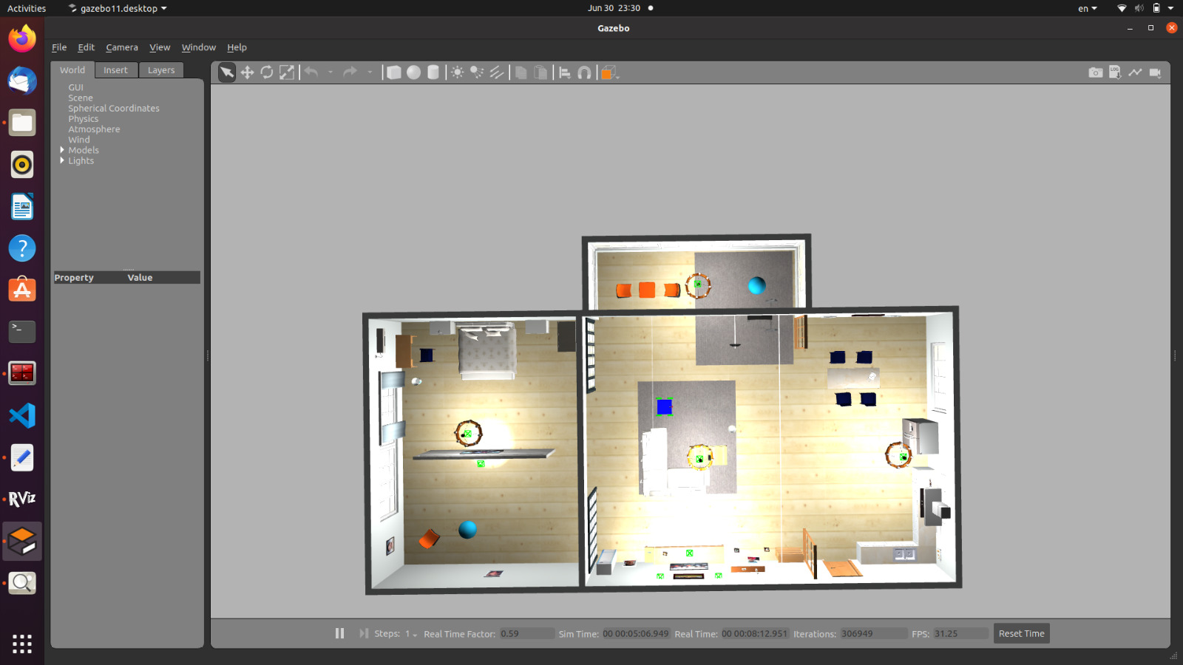
GAZEBO WORLDS
SEED SOWING ROBOT

Slide 44

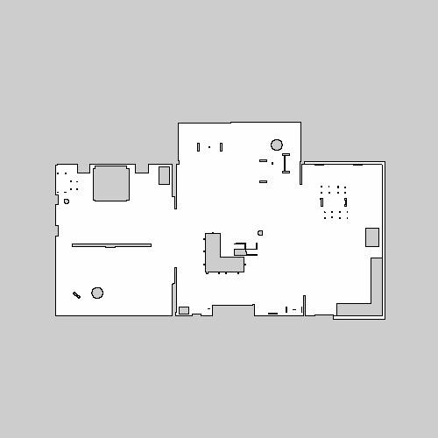
MAPS
SEED SOWING ROBOT

Slide 45
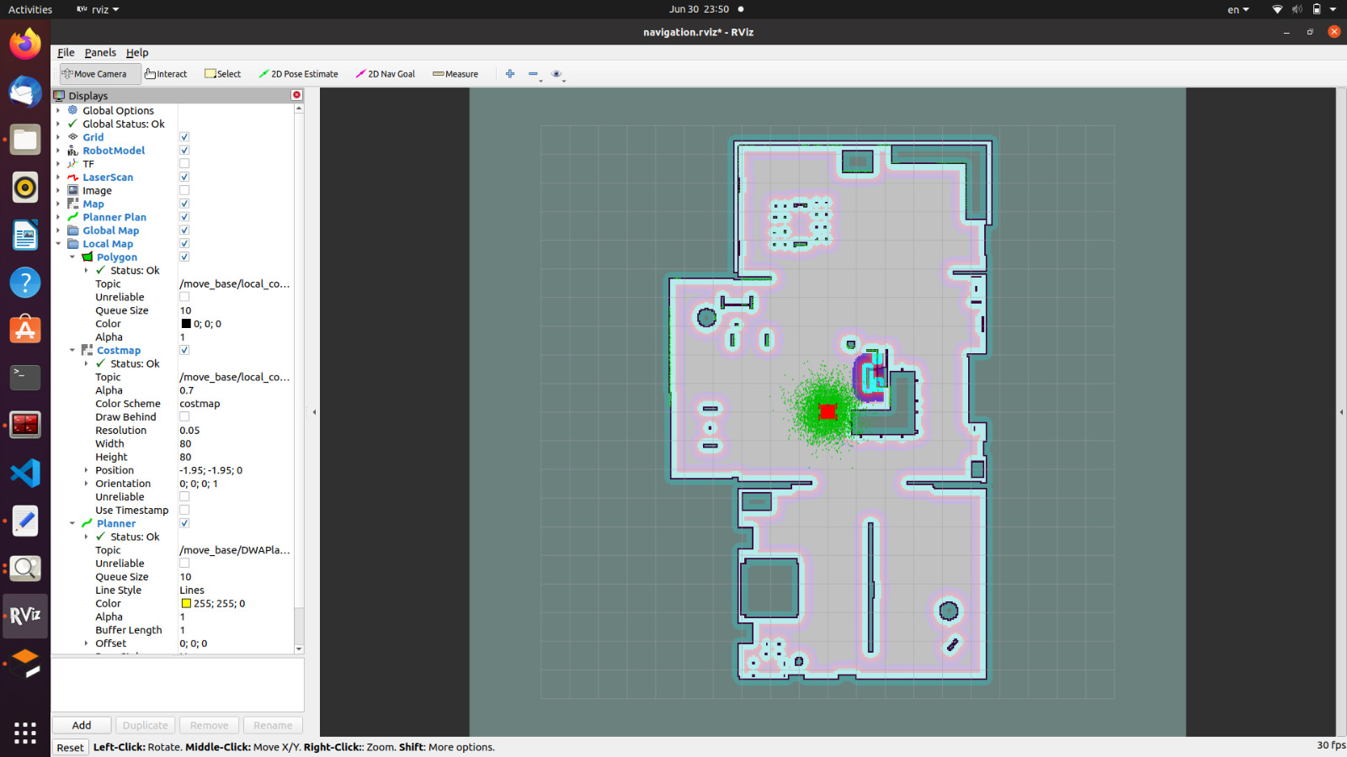
LOCALIZATION
SEED SOWING ROBOT

Slide 46
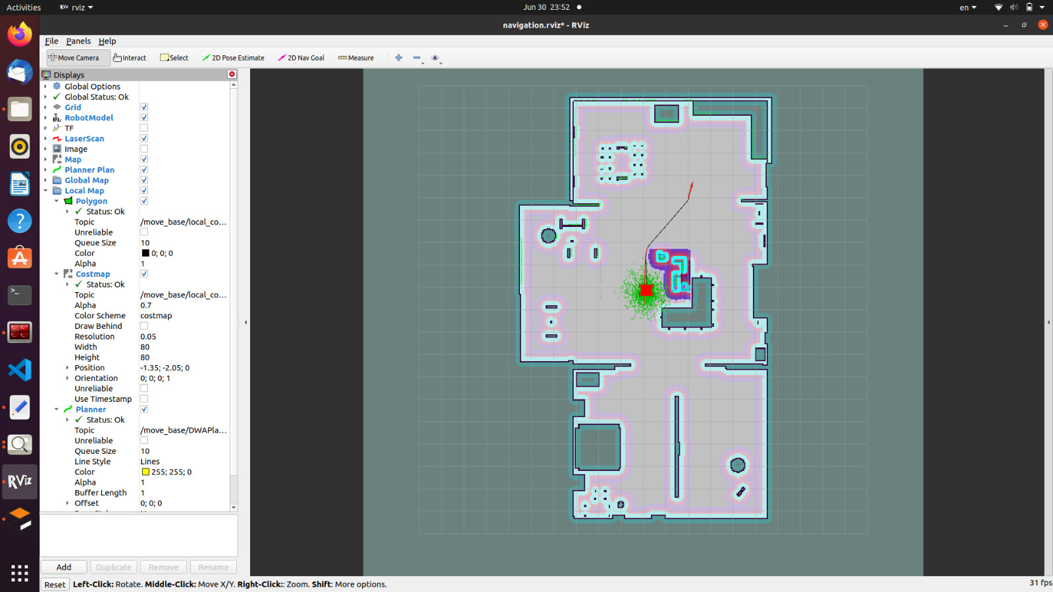
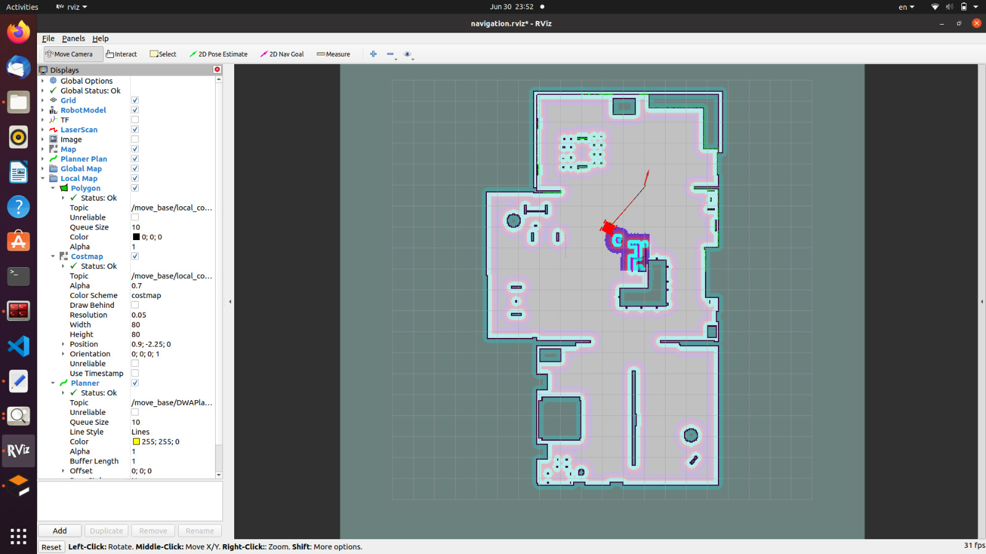
NAVIGATION
SEED SOWING ROBOT

Slide 47


NAVIGATION
SEED SOWING ROBOT

Slide 48
SOFTWARE
07
SEED SOWING ROBOT

Slide 49

Communication
Rosserial:
Rosserial bridges the communication gap between ROS and microcontrollers, which are often used in embedded systems to control sensors, actuators, and other hardware components
SSH(Secure Shell Protocol) :
is a remote administration protocol that allows users to access, control, and modify their remote servers over the internet.
EX:
SSH –Y ubuntu@IP
SEED SOWING ROBOT

Slide 50

System configuration
SEED SOWING ROBOT

Slide 51

layout
SEED SOWING ROBOT

Slide 52

layout
SEED SOWING ROBOT

Slide 53

Rqt Graph
SEED SOWING ROBOT

Slide 54
THANKS
SEED SOWING ROBOT

